Slide 1
Machine Learning with Python
The Complete Course
TELCOMA

Slide 2
Module 2 Data Scientist’s Toolbox

Slide 3
Content:
Python - Quick recap
Python 2.7.x or 3.x ?
Installation and setup
Data types, functions and important packages
Data manipulation & Data Engineering
Data Visualization

Slide 4
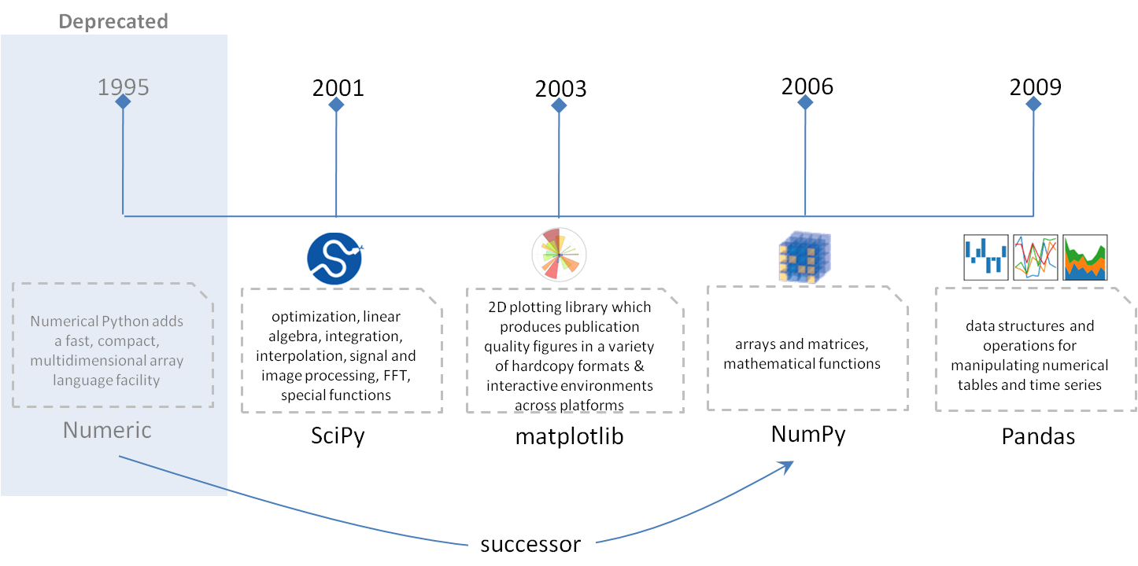
Quick recap – Python
Python got a lot of traction with the launch of Pandas, Scipy and Scikit Learn
highly popular, open-source and general purpose programming language
extensive production support
Preferred choice for Deep Learning
will soon overtake R as the preferred language for a data scientist
Popular packages
Pandas, numpy, matplotlib, scipy, statsmodel, scikit-learn

Slide 5

Python 2.7.x or 3.x?
Python 2.x is legacy, Python 3.x is the present and future of the language
Few Differences
Python 2.7.x
Python 3.x
Has more libraries
Extensive 3rd party module support
No new major releases
Cutting edge – all new features will be added to 3.x
Limited 3rd Party module support
Is under active development

Slide 6
Installation & setup
Windows Installation
Download the installer (32 or 64 bit)
Install the .exe file install and follow the installation wizard
Recommended distribution
– Anaconda Python 3.5.x
OSX Installation
Graphical Installer
Download the graphical installer
Double-click the downloaded .pkg file and follow the installation wizard
Command Line Installer
Download the command-line installer
In your terminal window type one of the below and follow the instructions: bash <Anaconda2-x.x.x-MacOSX-x86_64.sh>
What platforms are supported?
- Windows, Linux and Mac
(32 bit and 64 bit versions)
What tools do we use?
- IDE : Spyder/ Jupyter Notebooks
Linux Installation
Download the installer (32 or 64 bit)
In your terminal window type one of the below and follow the instructions: bash Anaconda2-x.x.x-Linux-x86_xx.sh
https://www.anaconda.com/download/
https://repo.continuum.io/archive/

Slide 7
Data types
List vs Tuple vs Set vs Dictionary?
List: Use when you need an ordered sequence of homogenous/heterogenous collections, whose values can be changed later in the program
Tuple: Use when you need an ordered sequence of heterogeneous collections whose values need not be changed later in the program
Set: ideal when we don’t have to store duplicates and you are not concerned about the order or the items.
Dictionary: ideal whenever we need to reference values with keys
Basic Data types
Boolean True, False
Integer -1,0,1 (32 bits of precision)
Long 1234 (unlimited precision)
Float 3.21456, 6.3
Complex 2+9j (numbers with real and imaginary part)
String ‘This is a string’
Dictionary {‘A’ : ’item1’, ‘B’ : ‘item2’}
File f=open(‘path/filename’,’rb’)
List [1,2,4,5]
Set set(1,’ML’,2)
Tuple [1,2,3,5]

Slide 8
Demo

Slide 9
Data types continued..
A sample numpy array with 10 rows and 3 columns
Numpy
 | 0 | 1 | 2
0 | 12 | 13 | 35
1 | 14 | 16 | 56
2 | 15 | 19 | 77
3 | 17 | 22 | 98
4 | 18 | 25 | 119
5 | 20 | 28 | 140
6 | 21 | 31 | 161
7 | 23 | 34 | 182
8 | 24 | 37 | 203
9 | 26 | 40 | 224
10 | 27 | 43 | 245
NumPy’s main object is the homogeneous multidimensional array. It has an associated fast math functions that operate on it. It also provides simple routines for linear algebra and fft and sophisticated random-number generation.
E.g..
import numpy as np
a = np.arange(15).reshape(3, 5)
a
array([[ 0, 1, 2, 3, 4],
[ 5, 6, 7, 8, 9],
[10, 11, 12, 13, 14]])

Slide 10
Data types continued..
A sample pandas DataFrame with 8 rows and 3 columns
Index | Column1 | Column2 | Column3
1 | 100 | Andy | 1/1/1990
2 | 120 | Jake | 5/6/1985
3 | 140 | Bill | 17/05/2000
4 | 160 | Smith | 9/8/1980
5 | 180 | Jane | 1/12/1976
6 | 200 | Melvin | 17/05/2001
7 | 220 | Roger | 5/17/1971
8 | 240 | Rahul | 9/19/1966
Pandas
Series
1-dimensional labelled array capable of holding any data type.
DataFrame
A 2-dimensional labelled data structure with columns of potentially different types.
Analogous to spreadsheet or SQL table.
Note
The Series is the data structure for a single column of a DataFrame. The data in a DataFrame is actually stored in memory as a collection of Series.
A sample pandas Series with 8 rows
Download data from - https://www.kaggle.com/ludobenistant/hr-analytics/data

Slide 11
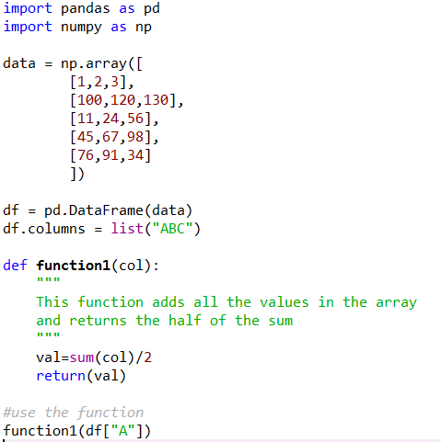
Functions
Sample
Function
A function is a block of organized, reusable code that is used to perform a single, related action.
Defining a function
Eg.
def functionname( parameters ):
"function_docstring"
function_suite
return [expression]

Slide 12
Demo

Slide 13
Data Manipulation and Engineering
Most elementary data manipulation exercises
- Reading CSV data from local system
- Exploring length and breadth of data
head/tail/shape/columns
- CRUD
- CR : add new columns/ create new dataframes
- U : update columns/filter
- D : delete columns
Data Engineering : Transform data
String manipulation
Data rollup (groupby)
Merge, Join, Pivot, concat

Slide 14
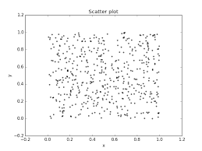
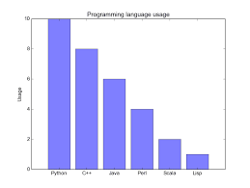
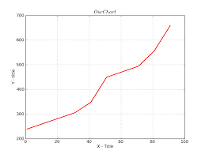
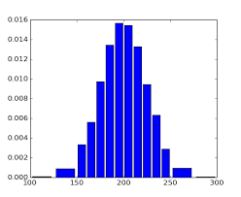
Data Visualization
Scatter plot
Bar charts
Line charts
Histogram

Slide 15
Demo

Slide 16
Next Module : Exploratory Data Analysis, Feature Engineering & Hypothesis Testing

